Slide 1

NATO supporting Mine Action in Ukraine
Pavel Buček
Comprehensive Assistance Package (CAP) for Ukraine Team,
Defence and Security Cooperation Directorate, Operations Division
ZAGREB
12 October 2023

Slide 2
NATO track record and focus on Ukraine
NATO supporting efforts of partners in demining
Madrid summit (2022) decision to review the political framework for the Comprehensive Assistance Package for Ukraine
  NATO-Ukraine Comprehensive Assistance Package for Ukraine Trust Fund
Vilnius summit (2023) decisions:
  develop the CAP into a multi-year programme for Ukraine
  fund the CAP in a sustained and predictable way

Slide 3
Ukraine CAP Trust Fund
A single and dedicated financing instrument that enables projects through the Comprehensive Assistance Package (CAP) approved by NATO and Ukraine:
  Continued delivery of urgently needed non-lethal military assistance (sustainment) to Ukraine the remains a priority;
  Development of longer term strategic projects as a multi-year programme of support.
Objectives:
  To support Ukraine’s deterrence and defence in the short, medium, and long term;
  To help Ukraine perform defence and security sector reforms.

Slide 4
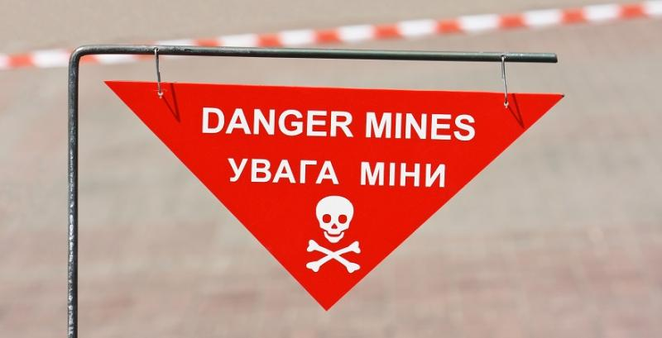
Ukraine CAP TF Sustainment Projects
Fully or Partially Delivered to Ukraine
21 projects delivered for a total of 115,221,309 EUR
16 projects pending delivery or contracting for 104,849,411 EUR
UCAP # 7.33 Demining Equipment
Total value: 127,298,490 EUR
Tranche # 1 value: 12,756,300 EUR
Portable Obstacle and Minefield Breaching System (quantity 900)

Slide 5
The Executing Agent for CAP TF projects
NATO Support and Procurement Agency (NSPA)
NATO Communication and Information Agency (NCIA)
Other possible national or international solutions
Executive Management Agreements recognize NSPA and NCIA as selected Executing Agents for the Ukraine CAP Trust Fund projects.

Slide 6
CAP Lines of Effort and Demining
Recovery and Reconstruction
  Demining and ammunition safety is part of a recovery LoE of the multi-year program
  Projects will mostly have form of capacity building, training and procurement.
Institution Building
Transition towards NATO interoperability

Slide 7
NATO vision and next steps in demining
NATO’s long term commitment in demining leading to sustainable recovery efforts
NATO's specialization in capacity building – possible directions
  Strengthening the capability of the demining units of the security and defense forces, including those engaged in underwater demining, by training and equipment
  Strengthening existing training centers and increasing the level of professional training of the security sector demining units
Projects to be discussed and adopted by the joint CAP management board

Slide 8
Coordination with Ukraine and Donors
NATO-Ukraine Council formats:
  Joint Working Group for Defence Reform (possibly a new committee in near future)
  Ad Hoc Working Group on Small Arms and Light Weapons and Mine Action
NATO representation in Ukraine (NRU)
  Ministry of Economy and other stakeholders
  The donor coordination platform under the chair of the First Deputy Prime Minister
  Local Donors’ coordination

Slide 9
Thank you for your attention.
Bucek.Pavel@hq.nato.int
+3227071377

