Slide 1

MINISTRY OF INTERIOR
CIVIL PROTECTION DIRECTORATE
MINE ACTION SYSTEM IN THE REPUBLIC OF CROATIA
ACHIEVEMENTS AND EXPERIENCES
Davor Laura, prof.
Cromac, Head of operations

Slide 2

MINE ACTION SYSTEM IN THE REPUBLIC OF CROATIA
Croatian Parliament
Commercial Demining Companies
Ministry of Interior
Government of the Republic of Croatia
STAKEHOLDERS
Local (regional) self-government Units
Ministry of Defence
CIVIL PROTECTION DIRECTORATE
CROMAC
Trade Unions and Employers' Associations
NGOs
General Public
EU UN
Media

Slide 3
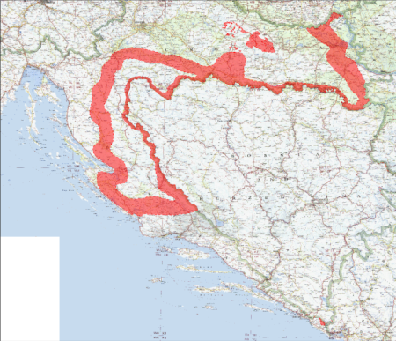
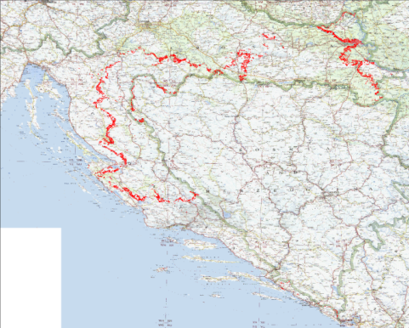
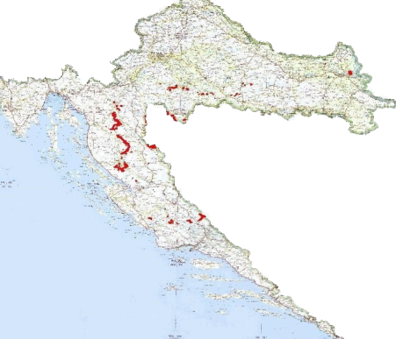
SYSTEMATIC OF MINE ACTION IN THE REPUBLIC OF CROATIA
LAND RELEASE ACHIVEMENTS
HA – first UN Assessment
HA- determined after the sistematic survey and marking of the entire territory of the Republic of Croatia
On the 2023, after systematic , intensive and continious work HA RoC =114 km² - SHA / CHA
HA 1996.
13.000 km²
HA 2005.
1.174 km²
MSA 2018.
241,1 km²
HA 2023.
114 km²

Slide 4
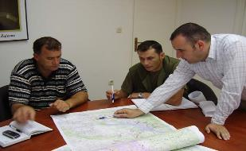
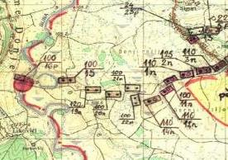
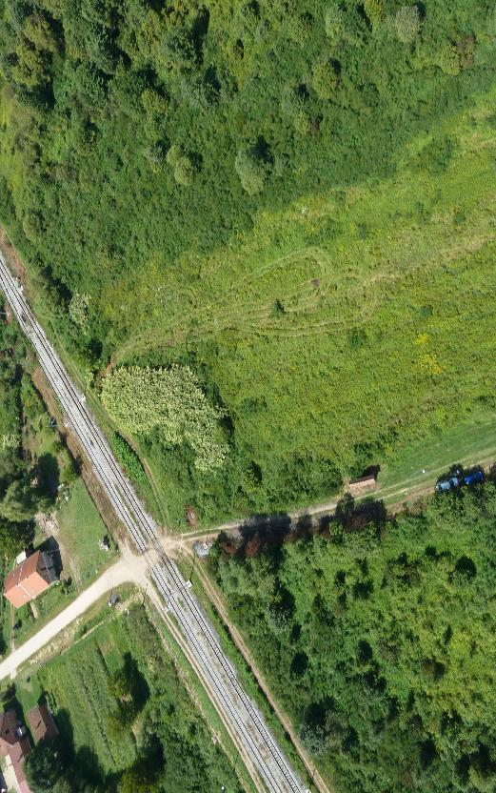
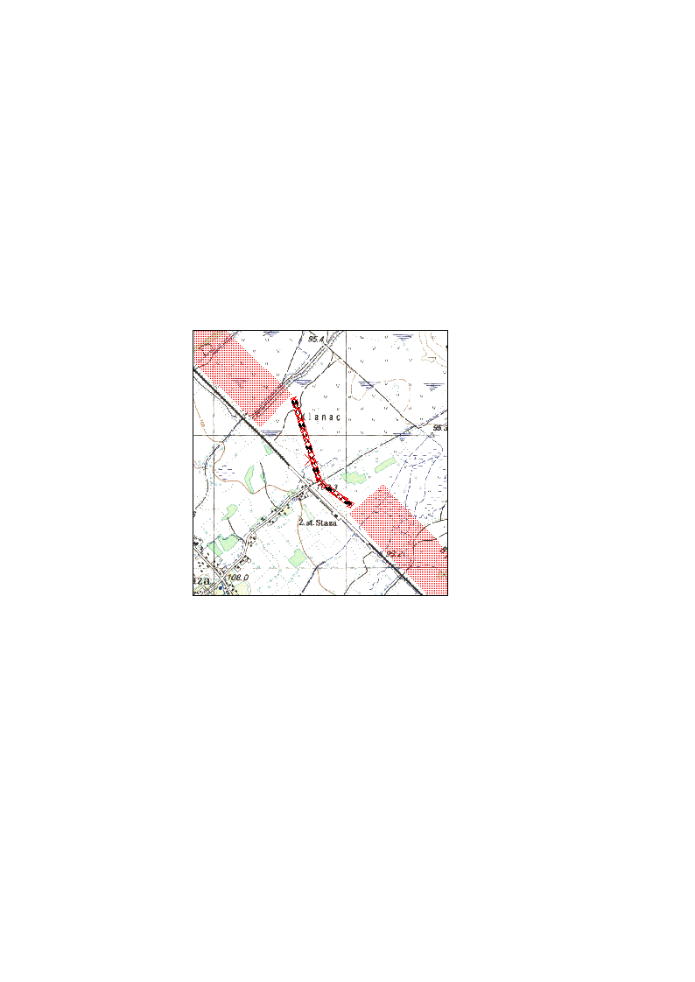
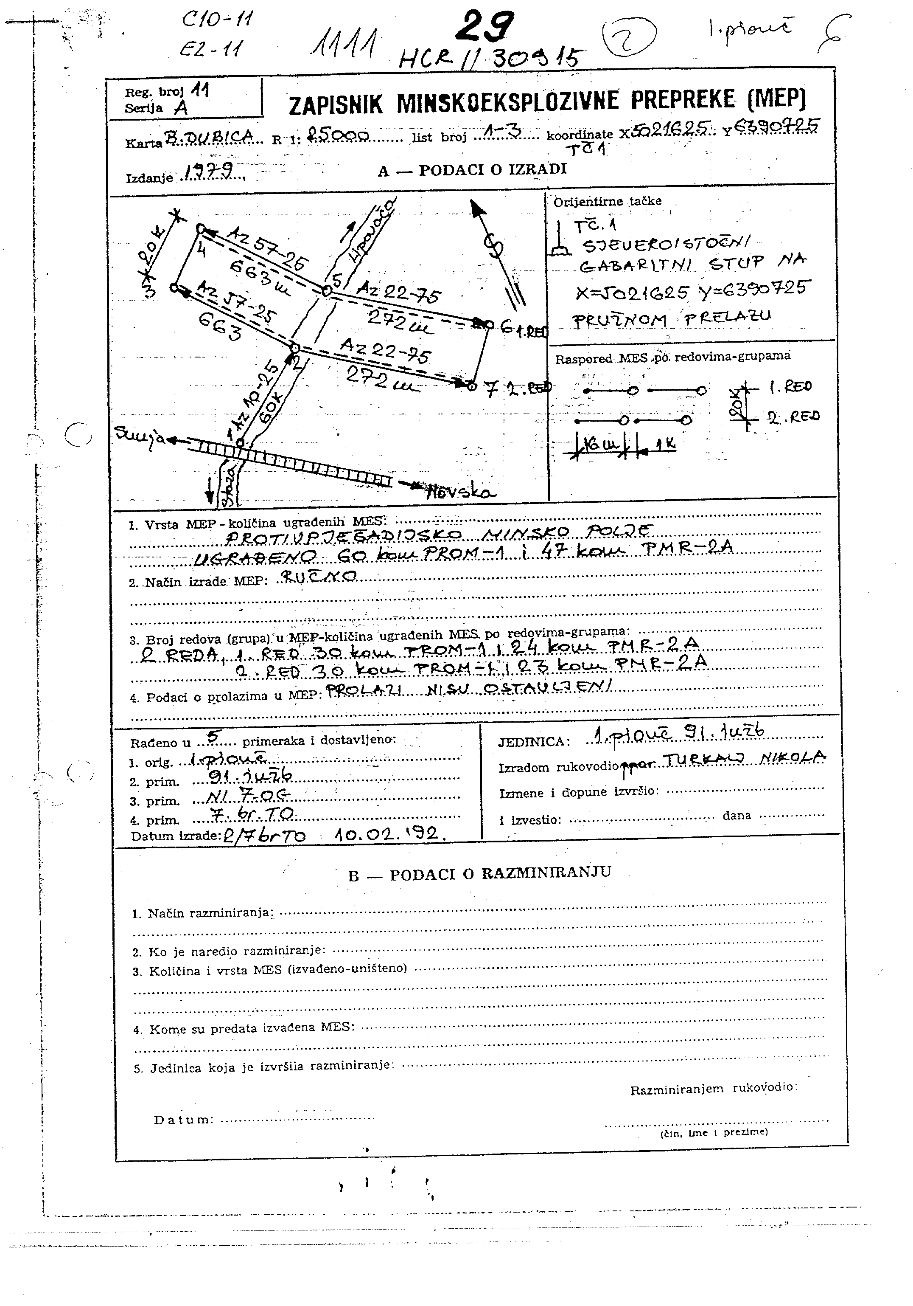
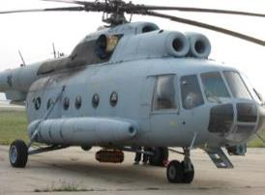
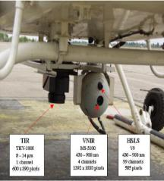
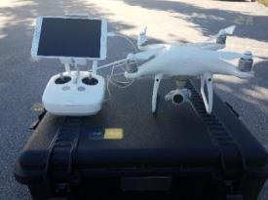
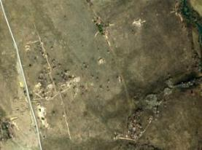
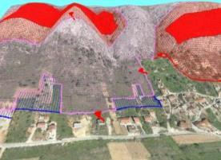
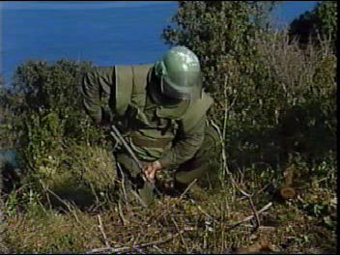
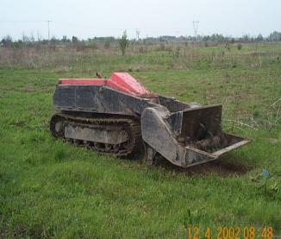
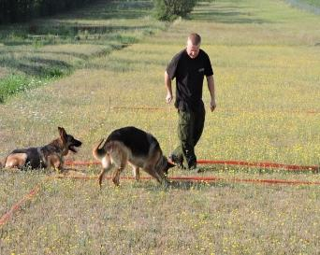
NON-TECHNICAL SURVEY
TECHNICAL SURVEY
CLEARANCE
LAND RELEASE OPERATIONS

Slide 5
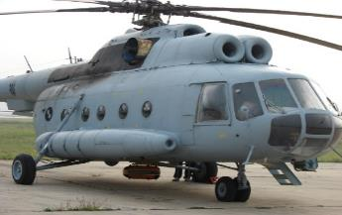
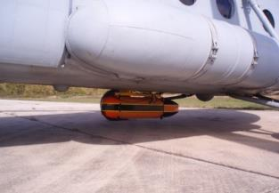
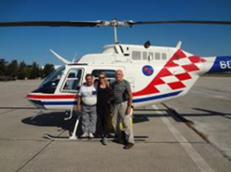
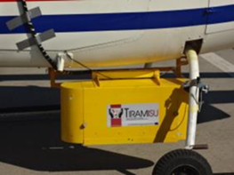
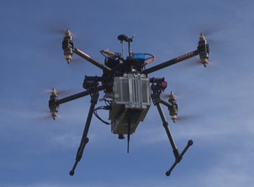

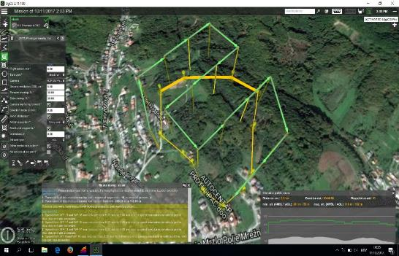
AERIAL NON-TECHNICAL SURVEY
Sensors container bellow helicopter Mi-8
Sensors container for helicopter Bell-206
Heavy and light multi-rotor Unmanned Aerial System
Notes:
For Non-Technical Surveys of large Suspected Hazardous Areas (SHA) the helicopters were used, Mi-8, flight autonomy – 4:15 h; Bell-206, flight autonomy - 2:15 h.
For Non-Technical Survey and Targeted Aerial Survey of smaller SHA were used Unmanned Aerial Systems, flight autonomy to 15 minutes.
Senors: digital photograpy camera (three visible channels, red, green, blue), multispectral camera (three visible and one near infrared channel), hyperspectral line scanner sensor (95 visible and near infrared channels), full frame hyperspectral sensor (125 visible and near infrared channels).

Slide 6
Pillars of Aerial Survey in the frame of NTS
1
MINE ACTION CENTRE
Mine action experts: analysis (MIS, GIS), general & special requirements on information and data acquisition
SCENE ANALYSIS
Satellite imagery
DEM terrain analysis Scene understanding, airborne mission planning, quality assessment of available Mine Field Records, Military Maps & information
MULTISENSOR AIRBORNE, IMAGERY ACQUISITION
INTERPRETATION
Imagery processing, use of expert knowledge, contextual information, indicators of mine presence, absence
OUTCOMES
Fusion, danger map, confidence map, proposal for reduction, map of conflicts MIS – Aerial NTS
5
2
4
3

Slide 7
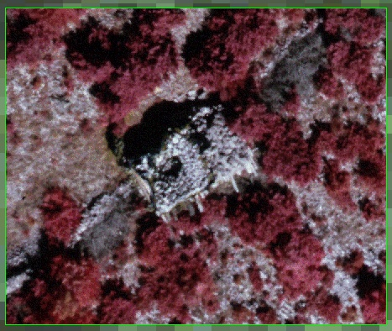
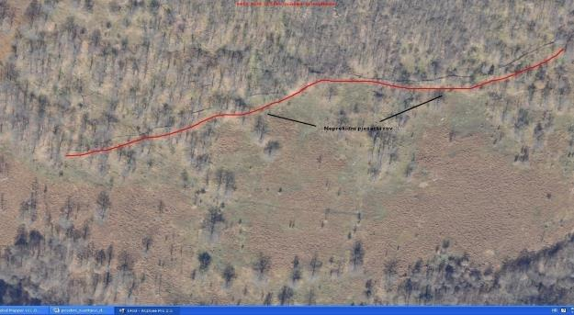
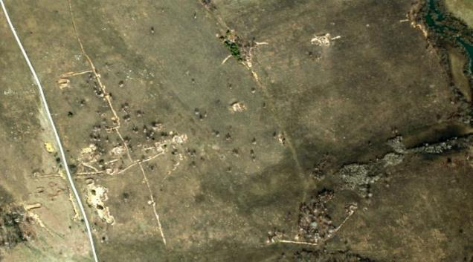
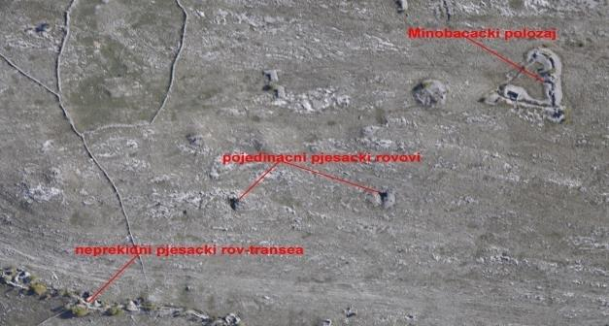
AERIAL NON-TECHNICAL SURVEY
STRONG INDICATIORS OF MINE PRESENCE
Notes:
Nakon što je sve potrebne podatke prikupio i pohranio u laptop radi plan terenskog izvida
- meeting
1. detailed analysis of previously collected data and preparation of initial analytical background (map) on MSA status for the field General Survey.
Analytic preparation is carried out through preparation of the following documents:
working topographic maps
a list of data to be collected, updated or verified by field General Survey.
list of persons believed to possess the original data on placing the minefields and other missing data on MSA status
marking situation,
2. Collecting and verification accordnig to the SOP with inadvance defined questions and procedures
Establish contact with person (persons) planned to have conversation
Execute the comparison of geographical-topographical data shown on the map with real field
situation
Precisely establish the existence of safe routes and previously demined surface areas
Carry out MSA marking with mine warning signs
Constant comnection with database
Obavjest na teren s novim stanjem MSP-a i novim pozicijama oznaka minske opasnnosti

Slide 8
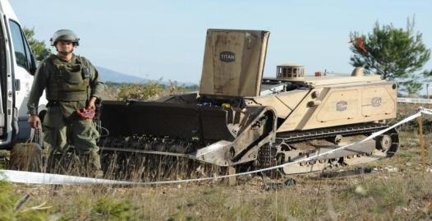
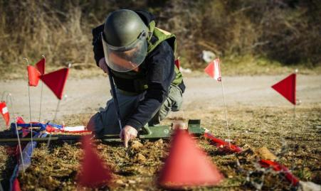

CAPACITY DEVELOPMENT
1991 to 1995: Civil protection, Ministry of the Interior and Croatian Army
1996 to 1998: AKD MUNGOS founded by the decision of the Government of the Republic of Croatia
1998 – present: Market principle through public tenders
Capacities
43 commercial companies
492 deminers
55 auxiliary workers in humanitarian demining
46 mine detection dogs (current certification)
44 demining machines (current certification)

Slide 9
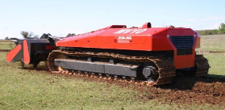
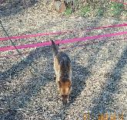
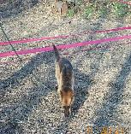

CURRENT HUMANITARIAN DEMINING CAPACITIES
RATIO BETWEEN DEMINERS, MINE DETECTION DOGS AND DEMINING MACHINES
12 : 2 : 1

Slide 10
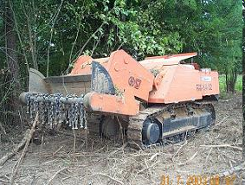
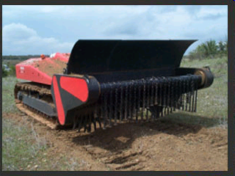
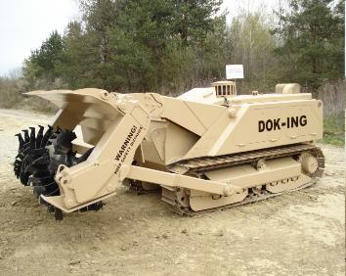
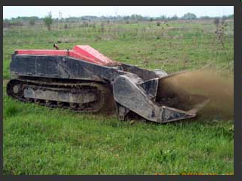
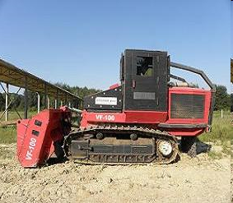
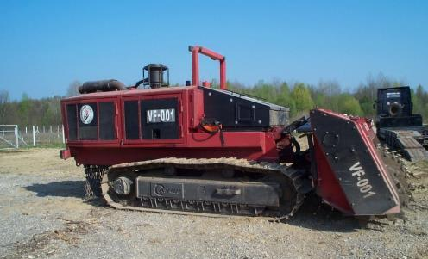
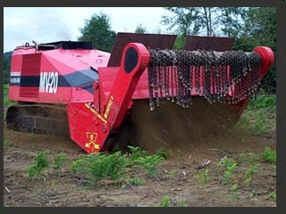
DEMINING MACHINES

Slide 11
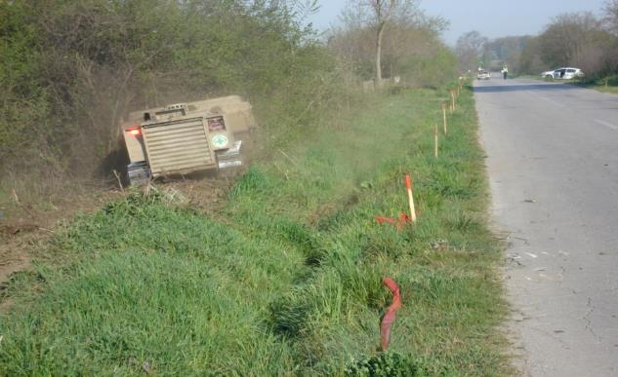
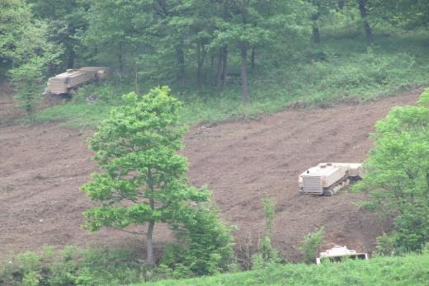
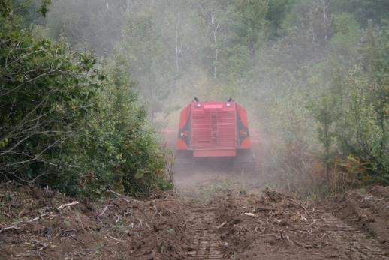

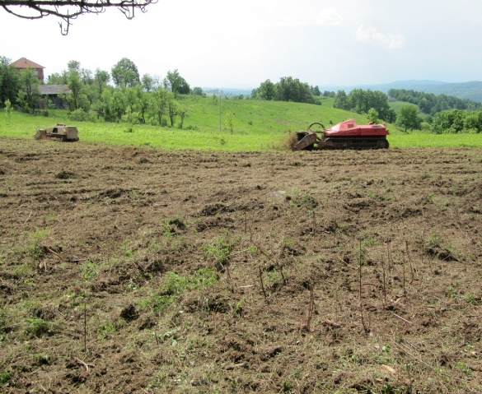
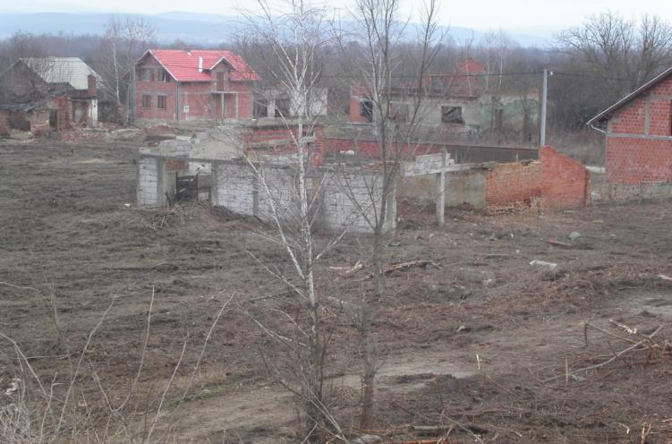
Infrastructure
Forests
Technical Survey/Mine Clearance
Agricultural productive land
Houses and houseyards

Slide 12
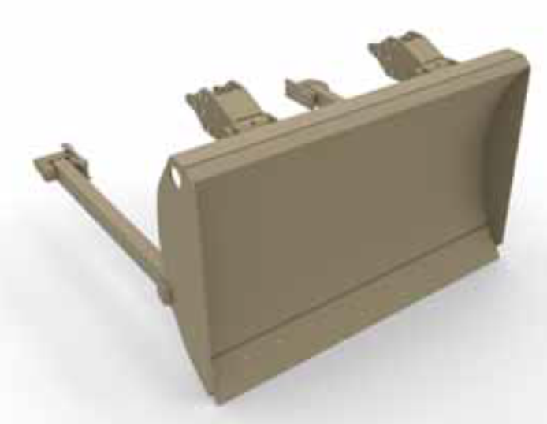
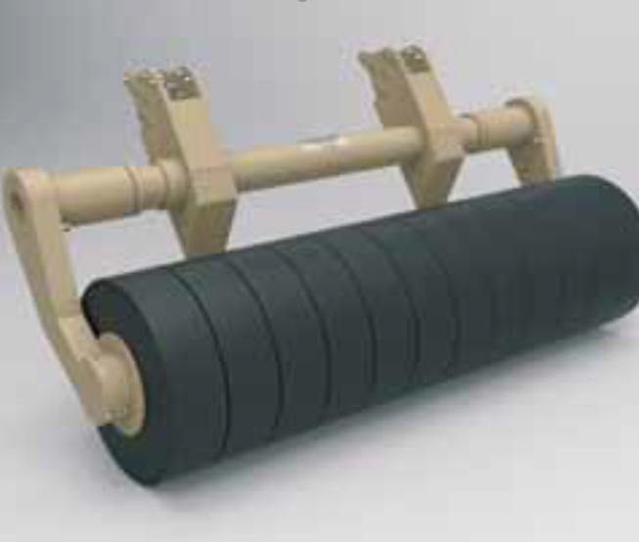
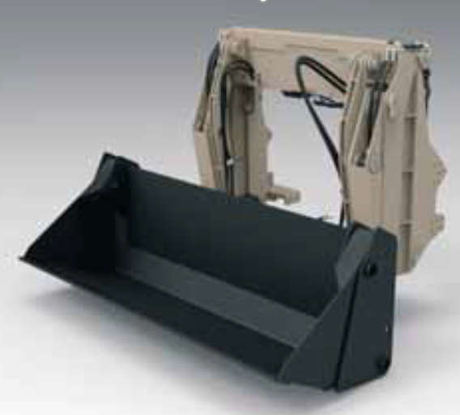
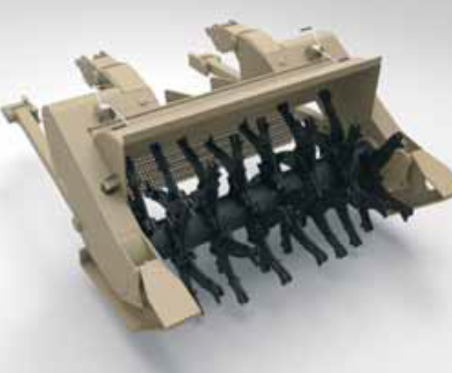
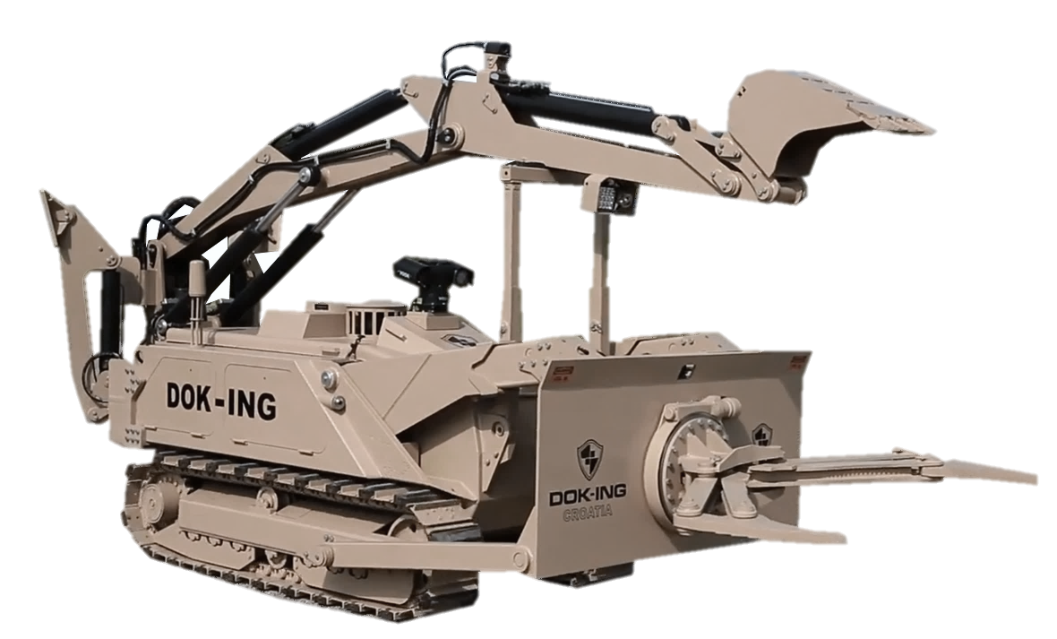
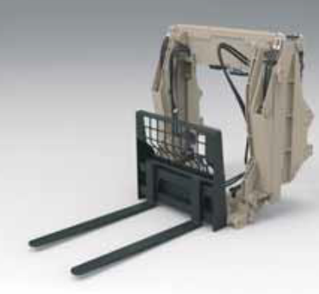
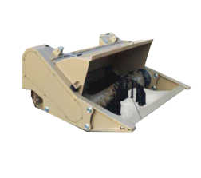



Multi Mission EOD Robotic System
  Major tools:
  Flail
  Tiller
  Rotational Gripper
  Dozer Blade
  Rear EOD Robotic Arm
  Extra tools:
  Segmented Roller
  Rear Shovel
  Rear Forklift
  Hydraulic cutter
  40mm stand-off recoilless disruptor

Slide 13









MINE INFORMATION SYSTEM
MIS development begins immediately after the CROMAC was established back in 1998 and consists of:
1. Database
2. Geographic Information System (GIS)
Data base:
- Mine field records evidence
- Survey evidence
- Monitoring records
- Records of mine accidents and victims
- Mine suspected area (MSA) records
- Analytical module
GIS:
- quality planning, preparation and implementation of NTS and TS
- Exclusion from mine suspected areas
- development of demining projects
- On-going supervision, final supervision and issuing a certificate of demined area submitted to the end user
- geospatial information browser

Slide 14






MINE INFORMATION SYSTEM
Thanks to the donation of Norway in March 2007, there was a highly sophisticated scanner installed and CROMAC SCAN CENTAR established.
It enables scanning of large format maps and other graphical information and their geocoding into the official co-ordinate system, vectorization of data from the maps and their distribution.

Slide 15

https://misportal.hcr.hr
2007. MIS-PORTAL project beginning
- Kingdom of Norway donation

Slide 16

Notes:
With MIS portal we gave information on the Suspected Hazardous Area to the wider population, that led to increasement in the security of the citizents of the Republic of Croatia and our guests.

Slide 17




MOBILE APPLICATION - MINEFIELD.info.hr

Slide 18

FINANCING OF MINE ACTION IN THE REPUBLIC OF CROATIA – 2023
Total funds: 1998-2023 reached approx. € 1.01 bn;
out of which roughly €198.4 mil or approx. 20% came from the various EU sources
National budget funding includes the financing from various state owned companies or public companies as well

Slide 19



MINE RISK EDUCATION and VICTIM ASSISTANCE
ASSISTANCE
- Emergency medical service
- Permanent medical aid
- Rehabilitation, prostheses, orthopedic aids
- Psychological and social care
- Employment and economic integration
- Legislation and raising awareness
- Access to public services
- Establishing a database
EDUCATION
- Educational Programs regarding Mine risk
- Integrated methodology towards mine problem solution
- Promotional activities
- Media campaigns

Slide 20
Priorities
Group | I Subgroup | II Subgroup | III Subgroup
SAFETY | Schools, hospitals, playgrounds | Areas near settelments | Forests near settelments
 | Settelments
 | Turistic destinations
 | Safety area near factories
 | All known minefields
SOCIO-ECONOMIC | Houses for reconstructioin | Agricultural land II category | Agricultural land III category
 | Agricultural land | Infrastructural objcts II category | Infrastructural objects III category
 | Infrastructural objcts | Parts of forests | Parts of forests
 | Parts of forests
ECOLOGY | Nacional parks | Parts of parks of nature | Parts of parks of nature
 | Wild depos | Forests for special puropses
 | Fire protection
Notes:
Existence of mines and unexploded ordnance on over 1.2% of the land area of the Republic of Croatia directly affects the implementation of measures intended for protection of lives and property of citizens. In the previous period, demining priorities were: reconstruction of houses, traffic and utility infrastructure, canals, embankments and areas in the close vicinity of settlements. Based on the analysis of MSA structure, mined agricultural and forest areas represent the biggest problem for the economy. Mined forest areas are currently estimated according to commercial standards to be worth 170 million EUR. The annual loss due to that fact is about 33 million EUR, while the loss in the field of agriculture on the annual level approximates 15 million EUR. With adequate funding, all agricultural areas can be cleaned up and make available for use by 2015.
Mine suspected agricultural area totals 140 km2 most of which is state-owned. The idea of the program of state-owned land management is to improve agricultural production and use the EU pre-accession funds to make new vineyards, orchards and olive groves. Demining is a precondition that needs to be met prior to all.
Since the very beginning of mine clearance, one of the priorities was to create conditions for safe road and railway communication in the Republic of Croatia. In order to do that, the areas along the communications first had to be demined as well as some parts of national parks and parks of nature defined as tourism and ecological priority.
Because of aforementioned reasons, Croatian Mine Action Centre has made the table of priorities in order to assist municipalities and counties in preparation of their proposals of demining priorities.
Priorities are devided in 3 main groups: safety, socio-economic and ecology.
Solving of mine problem relating to the first and second subgroup will result in removal of direct threat to the safety of citizens of Republic of Croatia. The areas important from socio-economic aspect will be demined as well as areas important for the protection of preserved nature, fire protection and recovery of illegal waste dumps.
Of the total planned area for demining in 2012, 49.8% referred to the security-related priorities, 45.9% to the socio-economic development, and 4.3% to environmental priorities. NEXT

Slide 21


MINE VICTIMS
Since 1996 there was 610 Mine Victims out of which 207 with fatality (including 134 deminers, out which 40 with a fatal outcome)
NO
MINE VICTIMS
IN 2017 AND 2018
Law on Civilian Victims of the Homeland War

Slide 22
CROATIAN ‘KNOW-HOW’
We can offer the following support to UKRAINE:
  Assistance in establishing of the National Mine Action Programmes and Centres
  Laws, bylaws in the Mine Action
  Assistance in establishment of Information Managament System in Mine Action
  Assistance in establishment of an effective Planning and Prioritizing system
  Assistance in establishment of Quality Managament
  Developing National Mine Action Strategies; Standards and Operational procedures
  Non-technical and Technical survey and defining of HAs, with the education of survey teams
  Education of Mine Action personnel
  EORE and training of EORE trainers
  Personal protective equipment and demining machinery manufactured in the Croatia
  Capacities, technology and knowledge of the commercial companies authorised for humanitarian demining
  Capacities for the testing of machines, equipment and devices and new methodologies for detecting explosive ordnance and UXO within CROMAC Centre for Testing, Development and Training, Ltd.

Slide 23


MINISTRY OF THE INTERIOR
CIVIL PROTECTION DIRECTORATE
CROMAC
Thank you for your attention!

