Slide 1
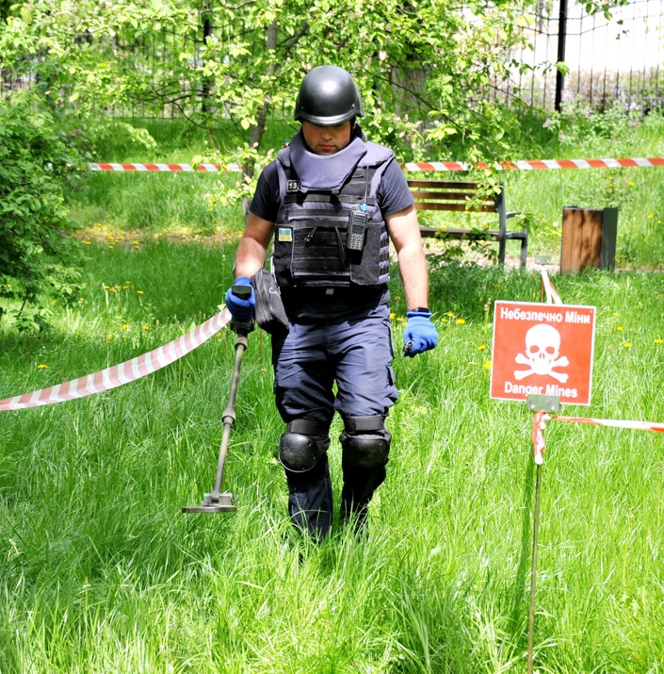
United Nations Mine Action in Ukraine
Thursday 12th Oct 2023 - Zagreb

Slide 2
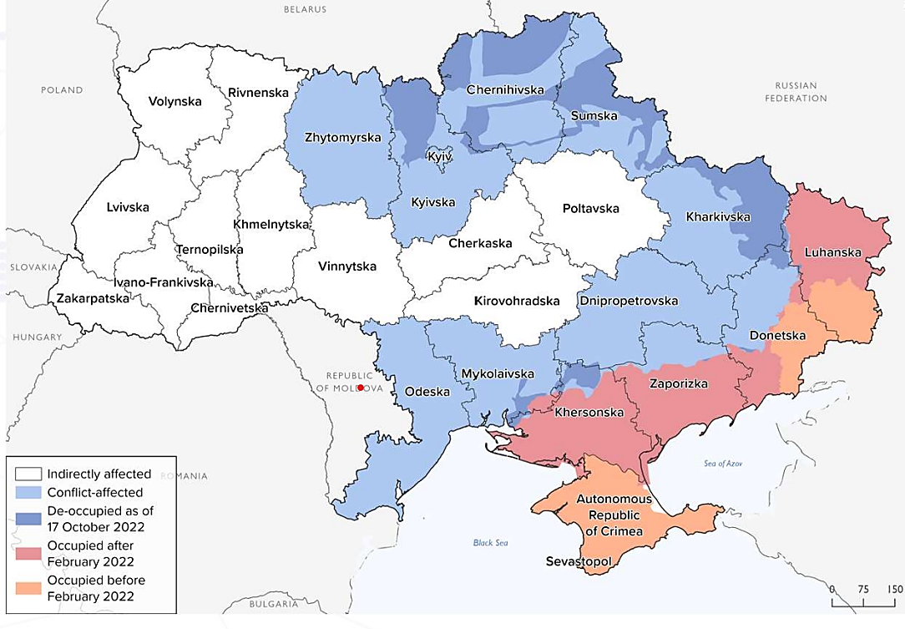
Context
ACCORDING TO AUTHORITIES, 175,000 SQ. KM OF UKRAINE’S TERRITORY HAS BEEN AFFECTED BY WAR AND MAY BE CONTAMINATED WITH LANDMINES AND EXPLOSIVE ORDNANCES

Slide 3
Context
Is the glass half full or half empty in Mine Action Ukraine?

Slide 4
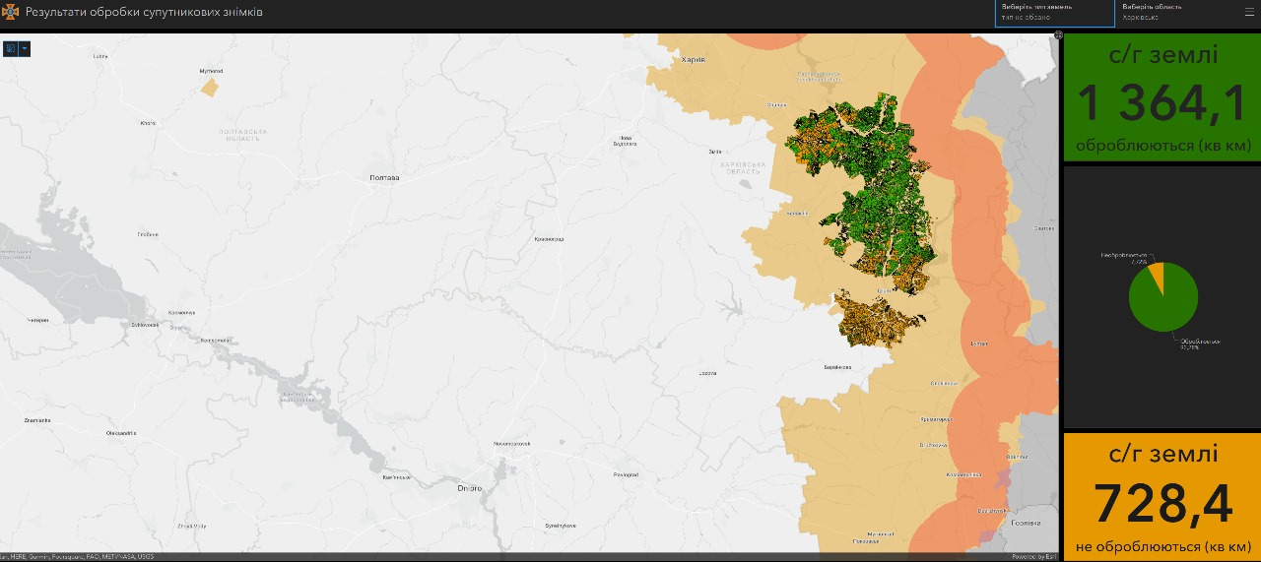
Rapid Progress Using Technology
Is the glass half full or half empty in Mine Action Ukraine?

Slide 5
Two approaches Required:
The Need for Outcome driven high impact demining NOT Output focused demining.
Why is the task a priority, what will be the positive outcomes achieved or negative outcomes avoided by undertaking this task at this time! How does clearing this task help Ukraine.
Adoption of a risk management approach not everything can be done immediately with no current or residual risk.
There are still incidents involving UXO in western Europe form WWI and II

Slide 6
Ukraine has two mine action problems not one:
The actual contamination from the detritus of war: Mine, UXO and other explosive contamination – probably the worst seen in Europe since the end of the second world war ! This will require extensive clearance operations conducted to international/Ukrainian standards.
The areas of land that areas suspected of being contaminated (primarily as a result of being occupied by Russian forces) that actually have no contamination and there is no evidence of contamination but the perception is they might be dangerous. This will require Innovative solutions and adoption of a reism management approach to mine action in Ukraine until land is confirmed as being contaminated or no evidence of mines is accepted.

Slide 7
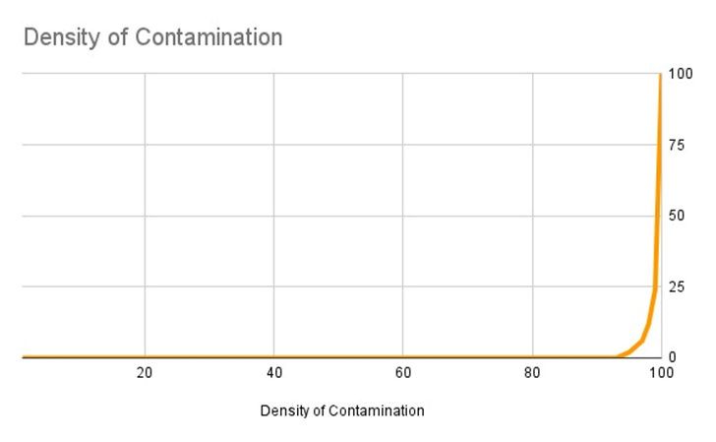

Slide 8
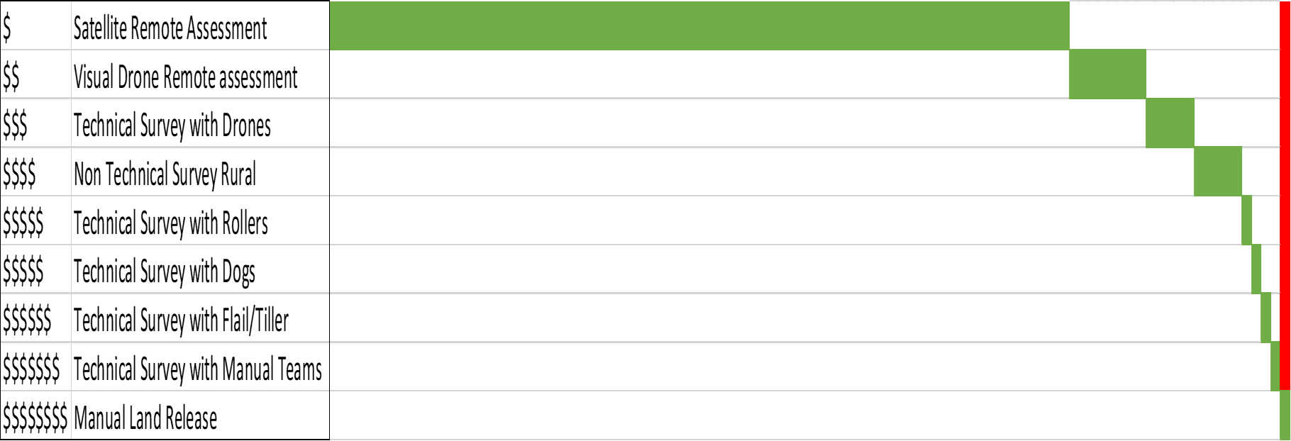

Slide 9
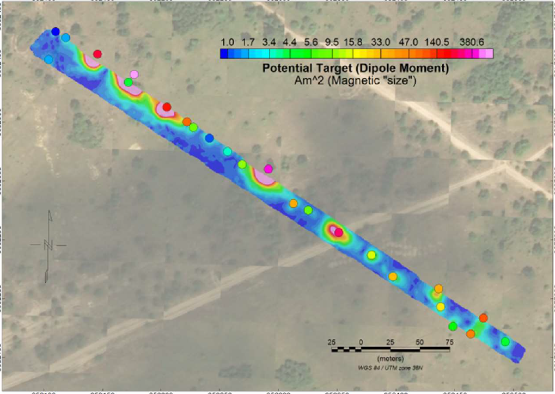
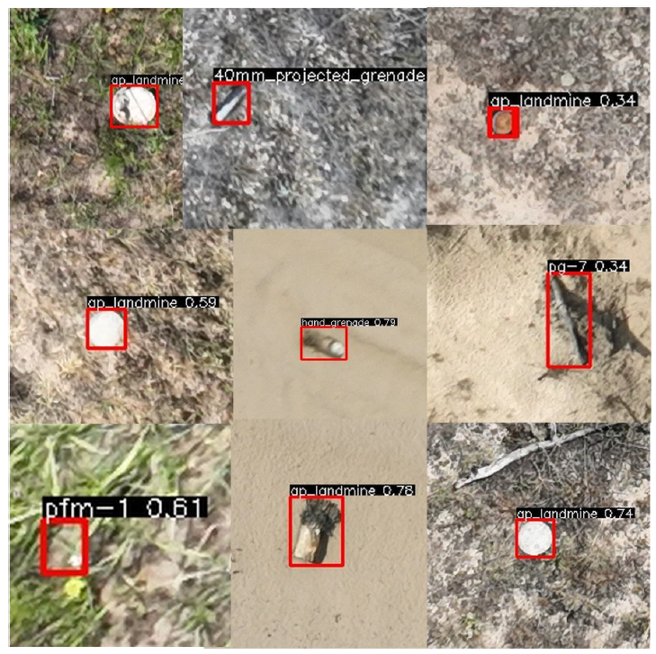
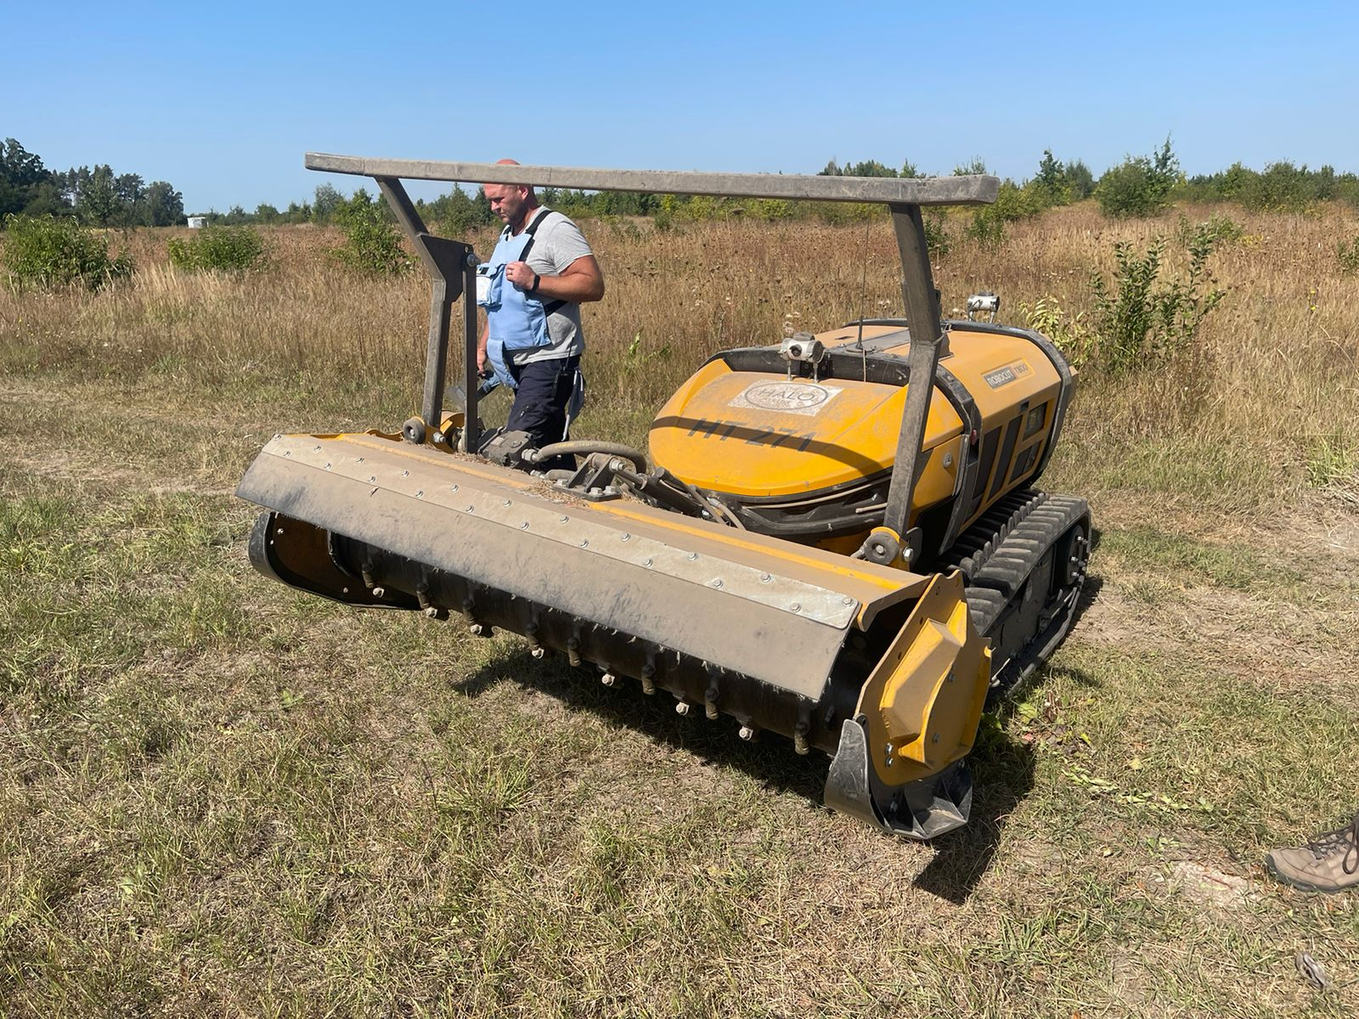
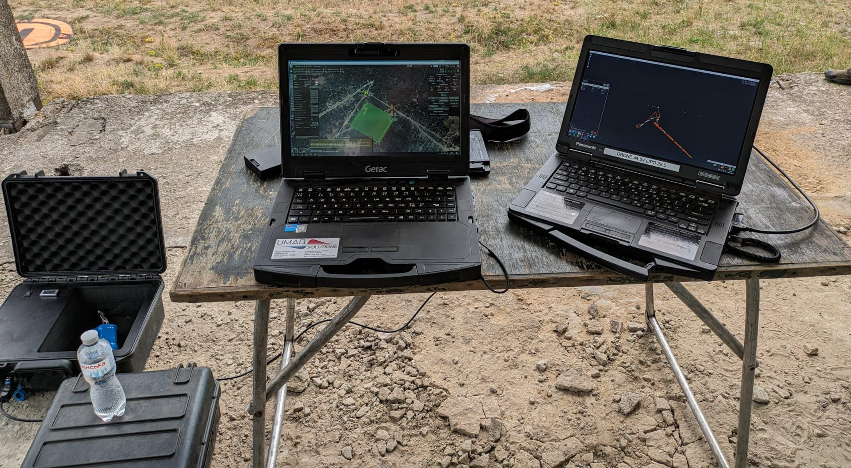
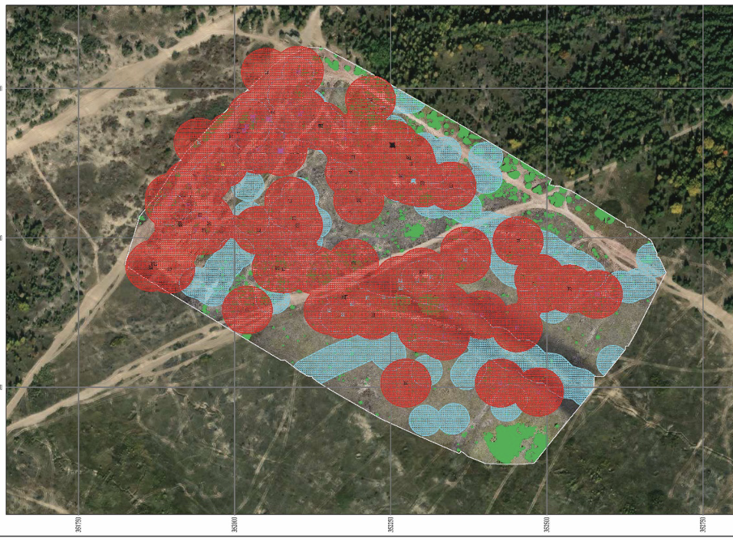
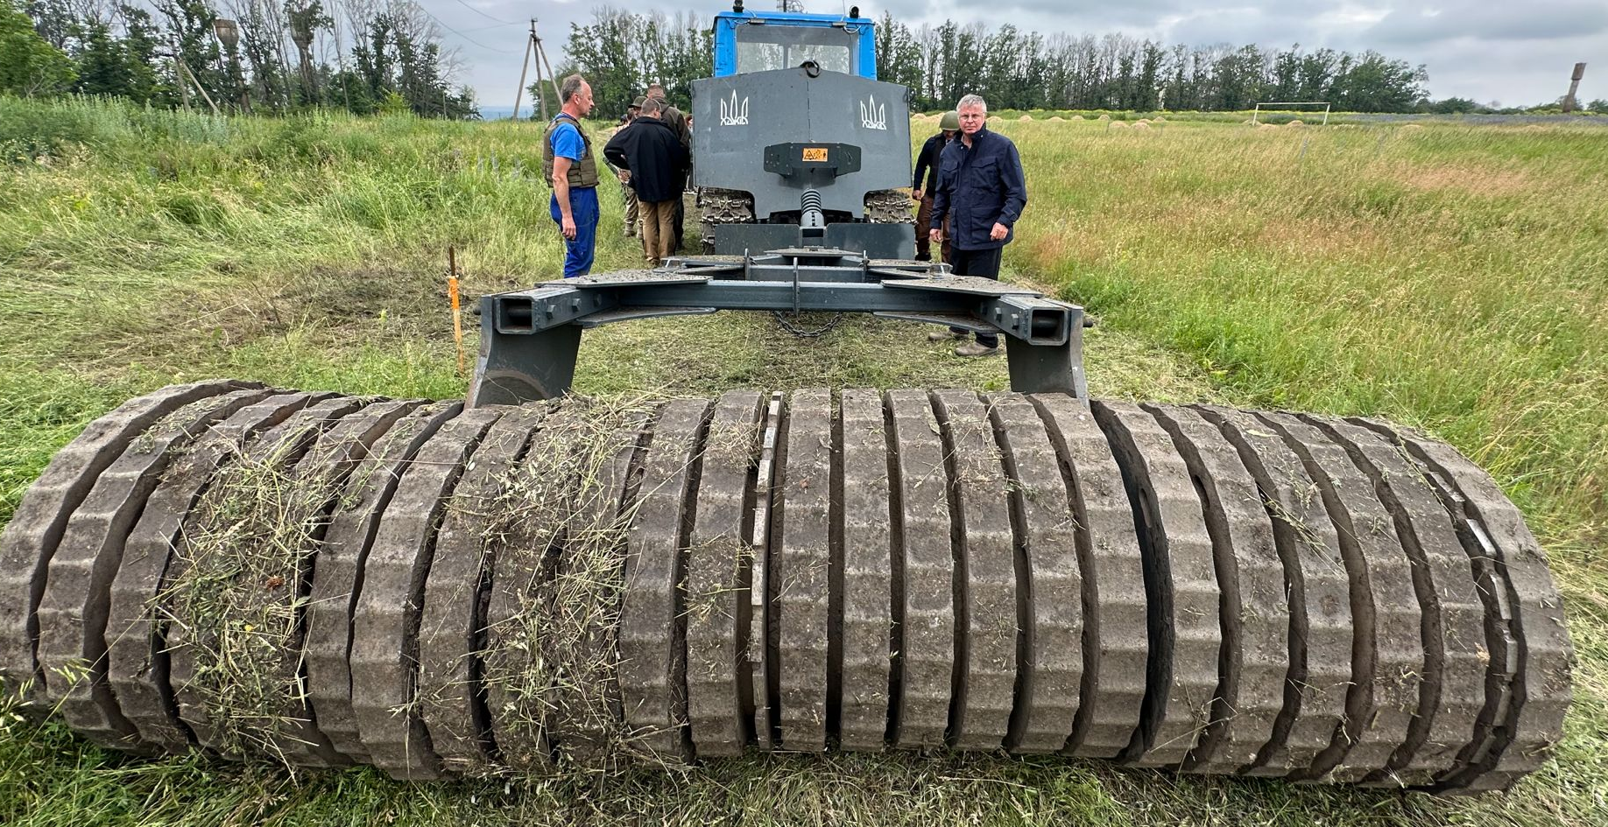
Impact & Innovation

Slide 10
The One UN approach in mine action in Ukraine pursues four impacts intended to capture the different strategic and long-term aims of the sector and strive for increased peace and human security, and support towards development in Ukraine - the common vision drawn from mine action global sector-wide Theory of Change (ToC).
1. Ukraine’s strategic objectives supported, and relevant treaty obligations met.
2. Increased community resilience to conflict drivers, contributes to stability and peacebuilding.
3. Economic development and more resilient communities contribute to Sustainable Development Goals (SDGs).
4. Safer communities and reduced deaths and injuries from mines and explosive remnants of war (ERW).

Slide 11
Denise Brown
Resident & Humanitarian Coordinator in Ukraine
rco.ukraine@un.org
Jaco Cilliers
UNDP Resident Representative in Ukraine
jaco.cilliers@undp.org
Paul Heslop
UNDP Ukraine Mine Action Programme Manager
paul.heslop@undp.org

